Slide 1

WarQuest
Created PlaatSoft

Slide 2
Game idea
Strategy War Game
Combine PC, Mobile and Online gaming
HTML, CSS, JavaScript based
Native browsers support
Chrome, Safari, Internet Explorer
Native clients (apps)
Windows, Android, Symbian S60
“iOS”

Slide 3


WarQuest – Logo
WarQuest

Slide 4
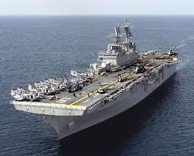

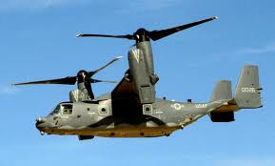
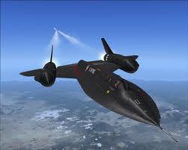


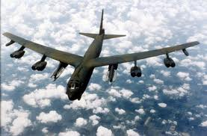
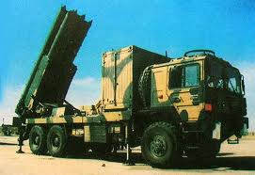

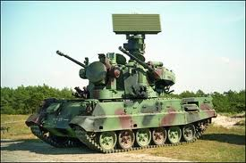
WarQuest – Features
Multi Player Online Game (MPOG)
Lots of unit types (more then 250)
Calvary, Navy, Aircrafts, Intelligence
Drones, Warriors, Spacecraft, Explorers
Lots of building types (more then 250)
Income
Defense
Energy
Discount
Maintenance
Lots of missions (more then 260)
Planets
Earth, Moon, Mars, Mercure, Neptune
Attack realtime other players round the world
Casino (Wheel Of Fortune, Slot Machine, TicTacToe)
Banks and Stock Exchange (NasDaq, Dow Jones, AEX)
Player Forums, Polls and Chat functionality
Leaderboards (Best Player, Best Country)
Multi language support (English, Dutch, German, Spain, etc..)
much more..

Slide 5
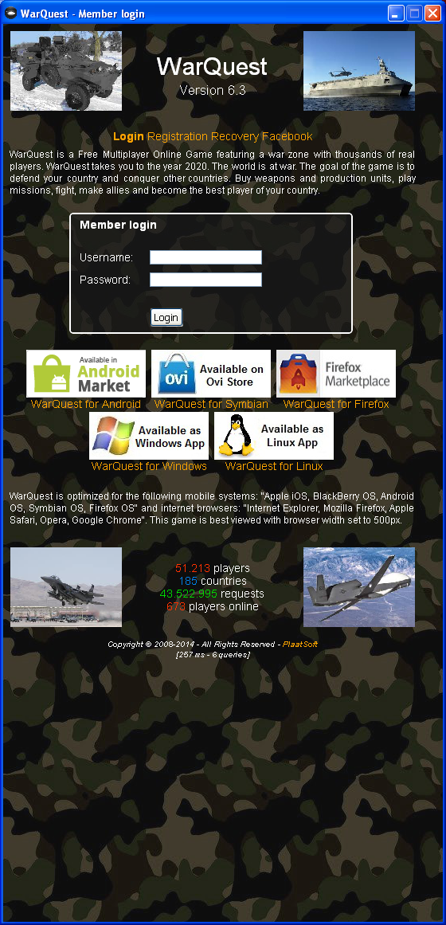
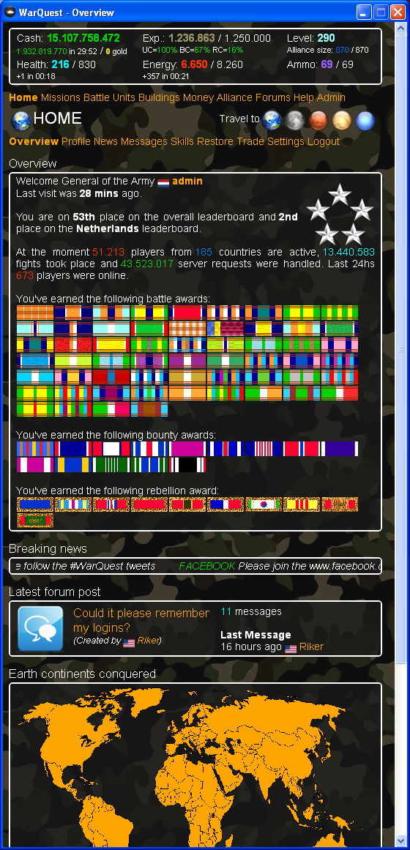
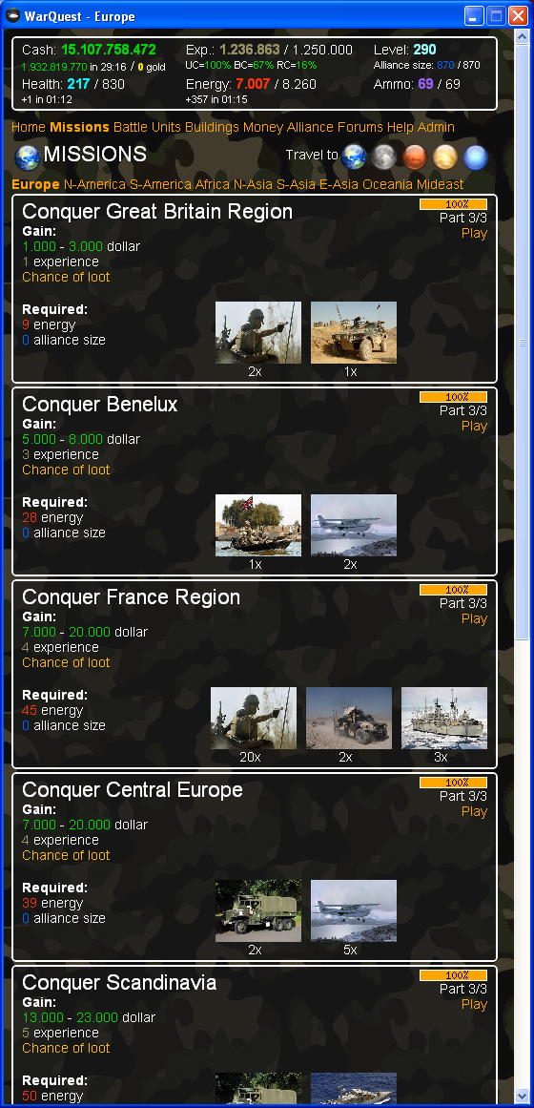
WarQuest – Screenshots [1/3]

Slide 6
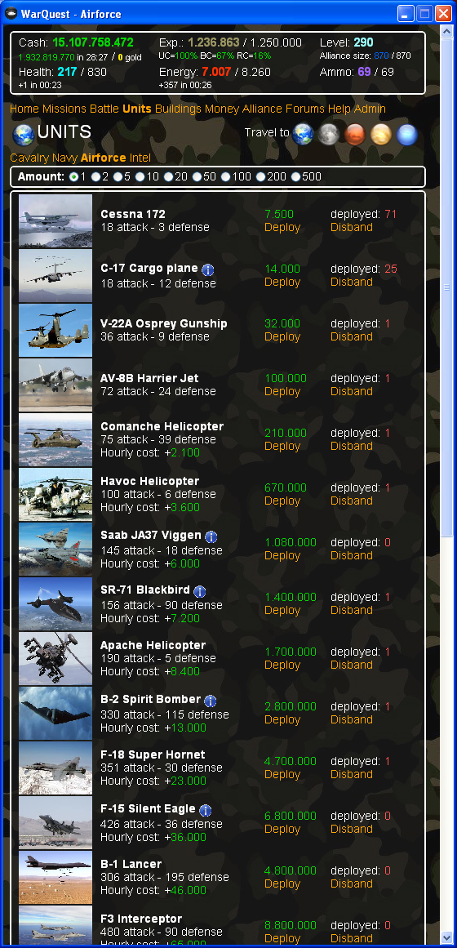
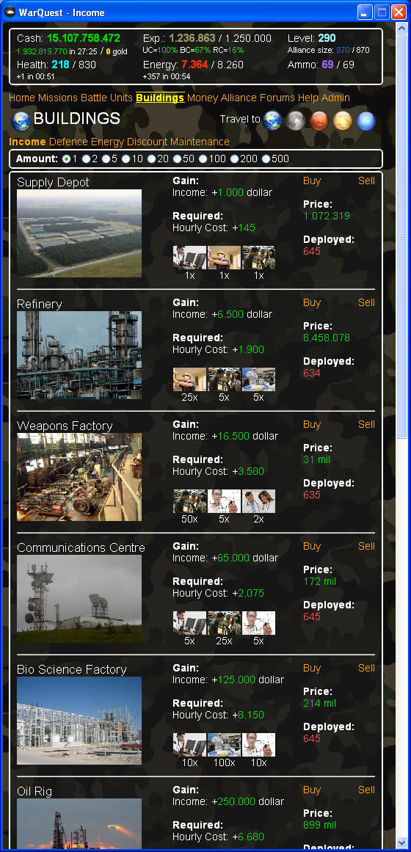
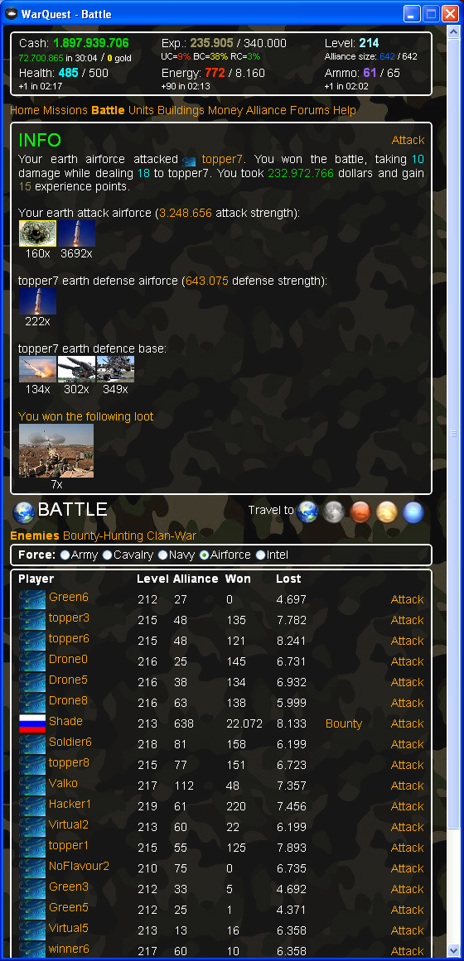
WarQuest – Screenshots [2/3]

Slide 7
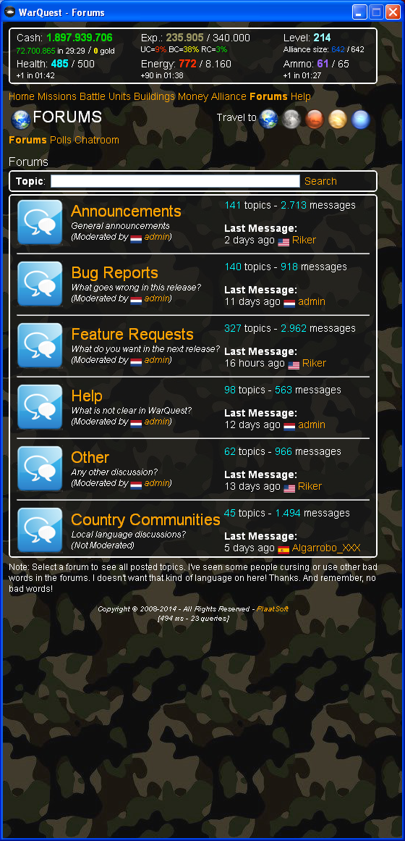
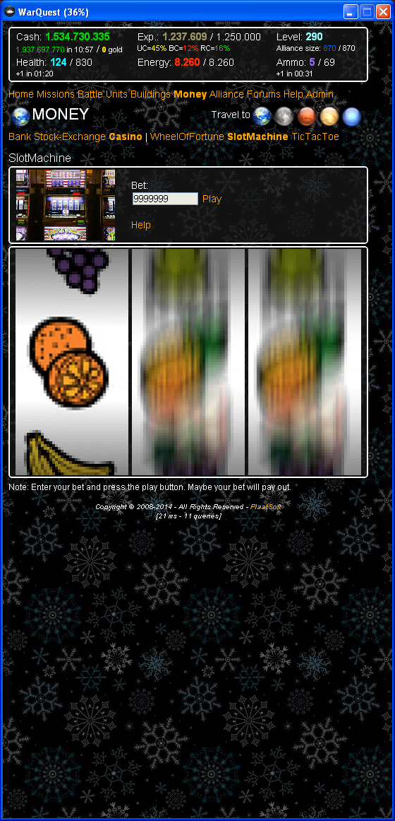
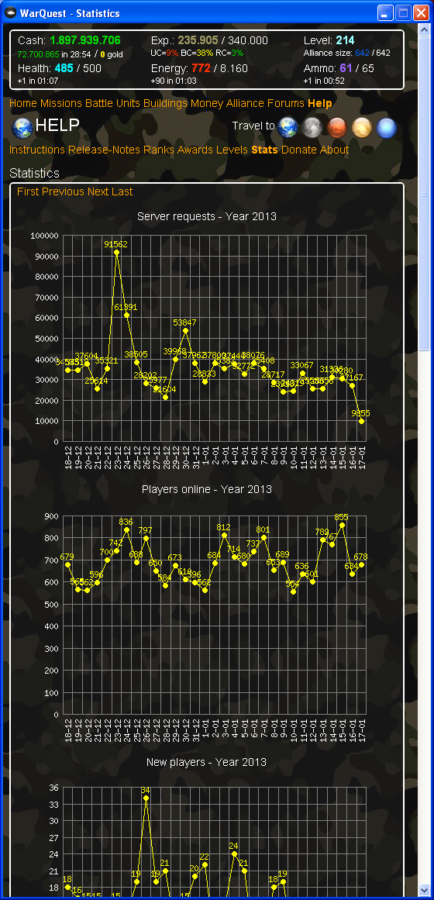
WarQuest – Screenshots [3/3]

Slide 8
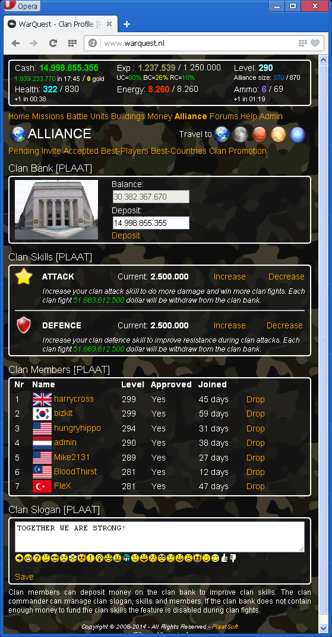
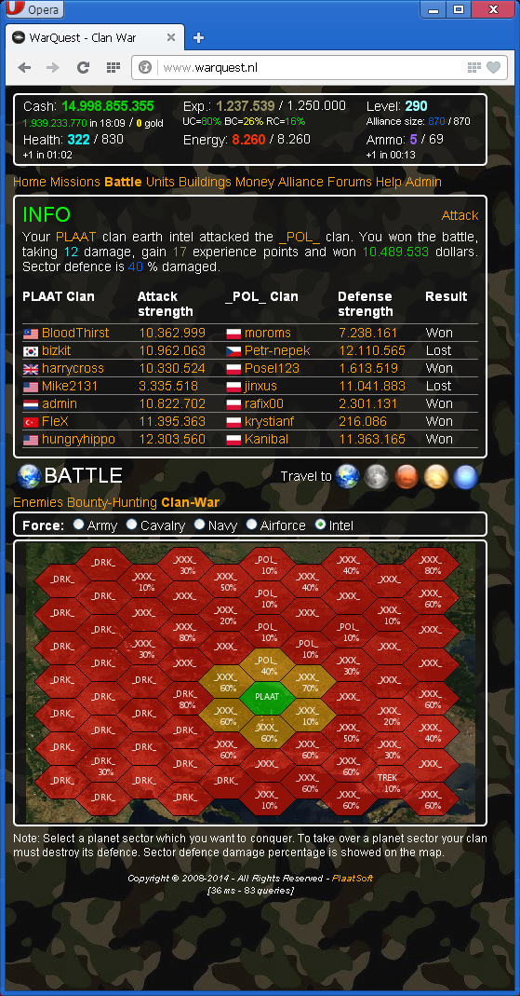
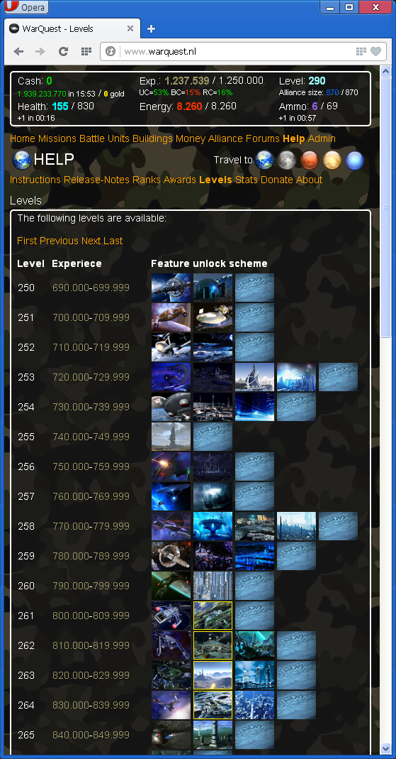
WarQuest – Clan War

Slide 9









WarQuest Client Site
Native Browsers
Game
Server
(HTML based)
www.warquest.nl
Internet
Android
App
“iOS
App”
Windows
App
Symbian App

Slide 10
WarQuest Server Site – Architecture
Image
Resources
CSS
Web UI
(PHP)
Java
Scripts
Language
Resources
Business Logic
Data Access
Web
Services
Cron jobs
Database
Audit
trail
Programming languages: PHP, JAVASCRIPT, HTML, CSS, SQL
Web Server: Apache
Database: MySQL

Slide 11
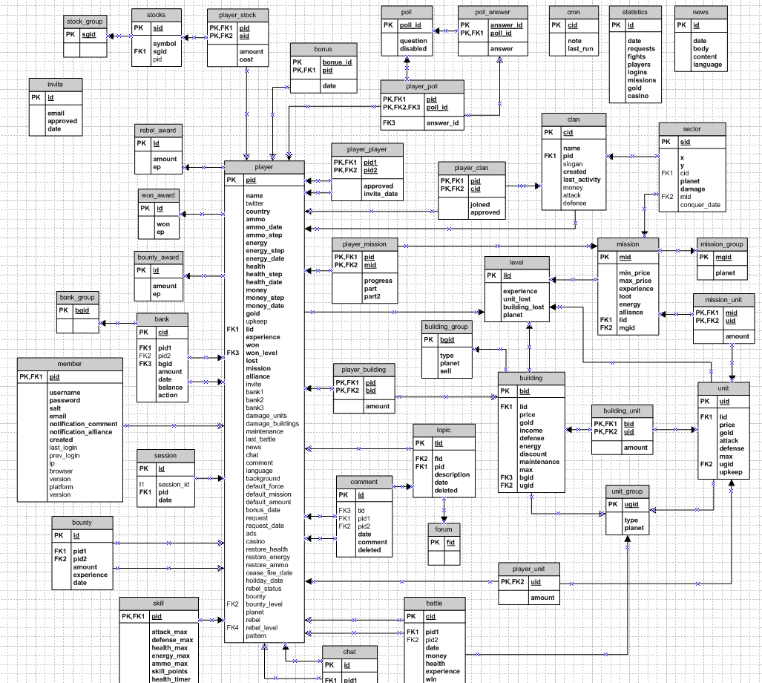
WarQuest – Data model

Slide 12








WarQuest – External web services
Internet
Game
Server
(HTML based)
www.warquest.nl

Slide 13
WarQuest – Hardware
Internet
82.243.195.130
82.243.195.170
Load Balancer
Mail
Server
82.243.195.141
82.243.195.142
82.243.195.143
82.243.195.144
Web Server 1
Web Server 2
Web Server 3
Web Server 4
82.243.195.201
Database
Cluster

Slide 14

WarQuest – Development Challenges [1/2]
Graphical Game Design
- Keep GUI simple for mobile devices
- Browser support - Internet Explorer
App (Client) Design
Keep it ultra simple
Use onboard native browser as must as possible
Auto Sign On / Auto Login
Performance
Current load
- Average 2 million HTML requests each month
Average page response 200 ms
- Optimize SQL queries as much as possible
Optimize PHP code / HTML output (Less is more)
Sound Support
Only HTML5 browser support

Slide 15
WarQuest – Development Challenges [2/2]
Framework (Android / Symbian) bugs
- Browser screen re-scaling (Android poor)
Adbrite Ads support (Android poor)
JavaScript support (Symbian poor)
Session Management
Native PHP session management do not support IP change
Security
- Prevent SQL insertion and Cross Side Scripting
- HTML links - Encrypt post parameters
JavaScript - Random token protection
PHP source code – Own encrypt algorithm developed
Cheating
Browser Back Button
Adapt HTML input parameters during java script running
Audit trail

Slide 16






WarQuest – Get Players [1/2]
Own website
plaatsoft.nl
Windows App
- freewarefiles.com
Android App
Android Market
market.android.com
Symbian App
Ovi store
store.ovi.com
Apple App
App Store
apple.com
Other Websites

Slide 17
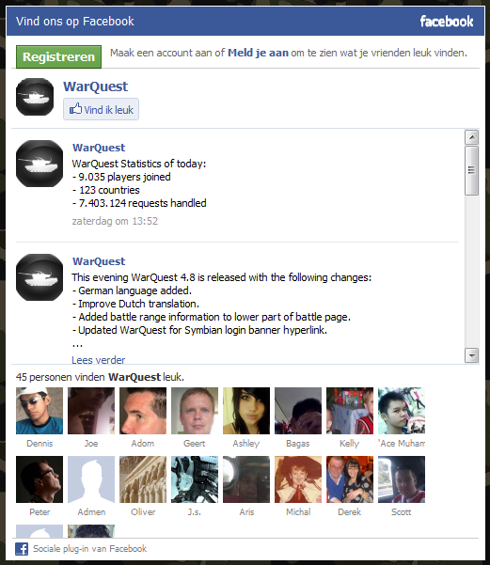
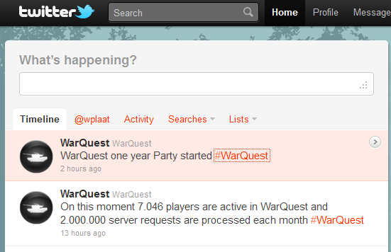
WarQuest – Get Players [2/2]
Facebook
Create facebook page
Invite friends
Create fanclub
Integrate facebook login
Twitter
Place Tweets #WarQuest
Integrate Twitter login

Slide 18


WarQuest – Leasons Learned
Android Market
Account ($25)
After 10 releases not in “new app list” anymore
Search “WarQuest” vs “PlaatSoft”
- Android Market player comments
Symbian Development
- Development tools getting better
- Simulator is still very poor
- Mobile screen sizes
OviStore publishing
Account ($1)
Publish account takes +/- 10 days
Each app deployment cycle +/- 5 days
Donate vs Showing Ads

Slide 19
WarQuest – Some players comments
awesome
“just started playing and i already think it is way better then any
of the storm8 games. i recommend it to everyone.”
Great game, well made and addictive! Better than Storm8 junk! Plus you can play
Great game, well made and addictive! Better than Storm8 junk! Plus you can play it on almost anything!
Great game
This is better than any other war game in the android market add me!
Fantastic War Sim for Android Phone
There are a LOT of things you can do in this game. Not just build and attack, repeat. The GUI is extremely intuitive as well. Several games like this but this is the best one by far. Also, it is FREE. No popups, no ads, ……………………

